Slide 1




How to start using Kudos

Slide 2

Logging on
Go to https://kudos.cascaid.co.uk/#/.
Now register and create your account using the licence code testarts87.
Lots more information regarding Kudos on @MyCollegeZone - Careers & Employability Hub.

Slide 3
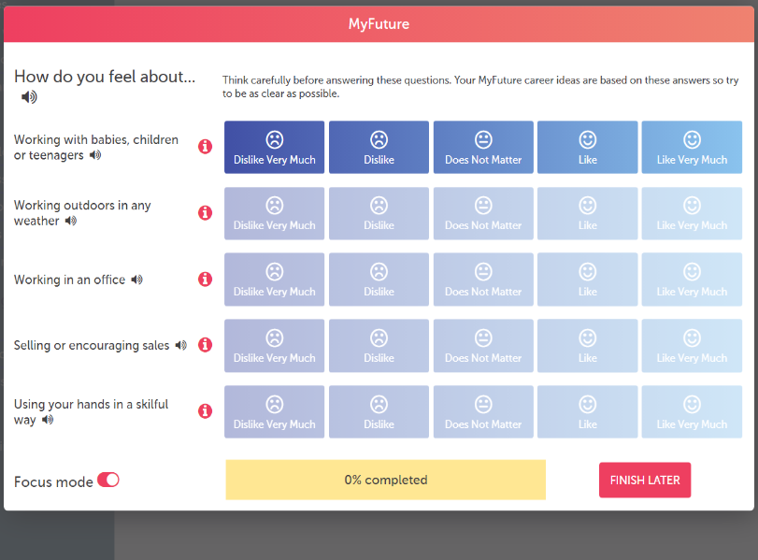
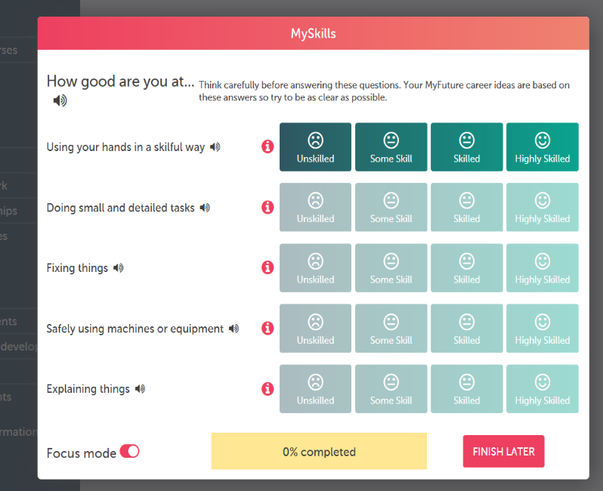
Complete the personality / skills quiz

Slide 4
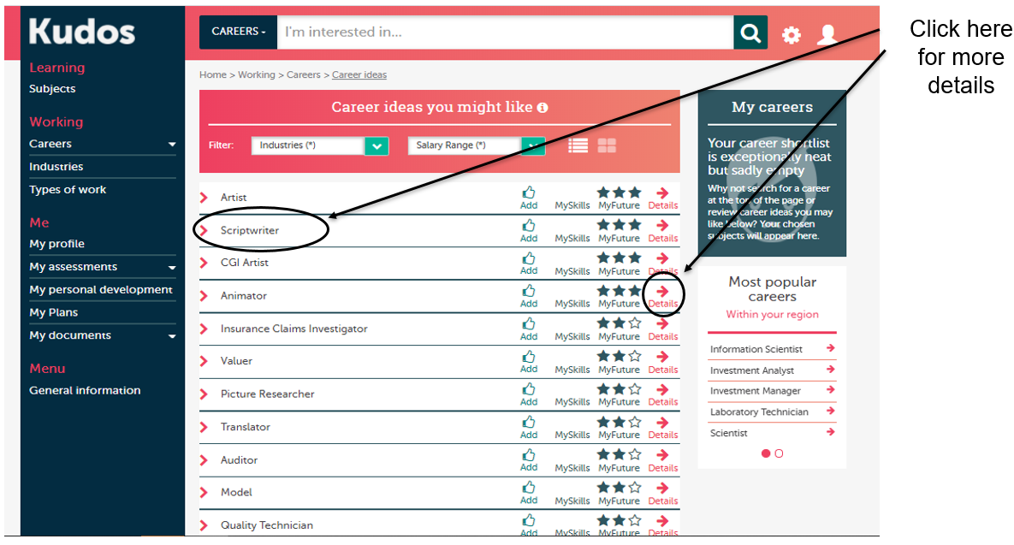
Career Ideas

Slide 5
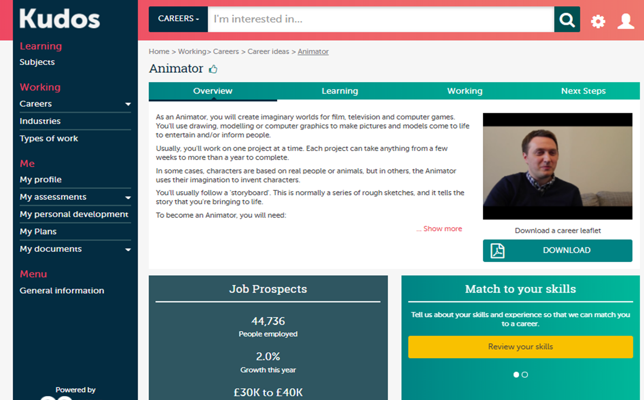
Career Information / LMI

Slide 6

Other Functionality in Kudos
Explore where different subjects can lead to.
Explore different industry sectors.
Search for university & college courses.
Search for employment and apprenticeships.
CV builder.
Personal statement builder.
Useful links signposting to other resources.

Slide 7




Contact Careers
If you need more information or have any unanswered questions, please do not hesitate to contact us in Careers.
KHR-G40 / CIC-109 (Tues & Fri)
0208 268 2555
careers@stcg.ac.uk
@MyCollegeZone –
Careers & Employability Hub

