Slide 1


Parents Information Evening
Sharon Muncie
Vice Principal

Slide 2







Parents’ Information Evening
5.00pm – Vice Principal’s welcome
Maths and English
Student Services
Employability
Inclusive Learning
5.20pm – Meet the Tutors
https://stcg.ac.uk/merton-college/parent

Slide 3
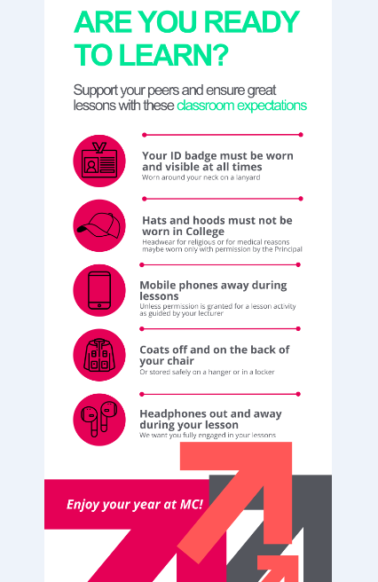
Classroom Expectations

Slide 4

Belonging
Enrichment activities
Group activities
Trips and visits
Student Council and Student Reps
Pastoral and academic tutorial

Slide 5
Safety at College
Always wear your lanyard and pass
Fire and Lockdown Drills – termly
Duty Manager
Bag searches and wanding - weekly
Knife Arches - termly
Zero tolerance for poor behaviour

Slide 6

English & Maths

Slide 7
English and Maths
It is a government requirement for any 16-19 learners, who do not have a grade 4 or above (or a Level 2 qualification) in English and maths, to enrol on the course at college.
Good English and Maths skills:
Enhance employment opportunities.
Help students succeed in their vocational course.
Can increase future income.
It’s a one year programme that focuses on the areas that students need to improve on to successfully complete their qualifications.
Students will learn a variety of skills to help them pass their GCSE exam/s in fun and engaging lessons.

Slide 8
English and Maths
Students have 3 hours of lessons each week
Attendance to all lessons is compulsory.
They must be on time for all lessons.

Slide 9
English and Maths
For any advice or queries please go to English and maths office: C110
Alternatively you can email:
Aneta.Armoogum@stcg.ac.uk (Deputy Head of School - English and Maths)

Slide 10








Learner Voice
Counselling and Wellbeing Hub
Financial Assistance
Welcome to
Student Support
Services
Safeguarding
Student Life &
Enrichment
1-2-1 support with Personal Issues
Careers Information Advice and Guidance

Slide 11
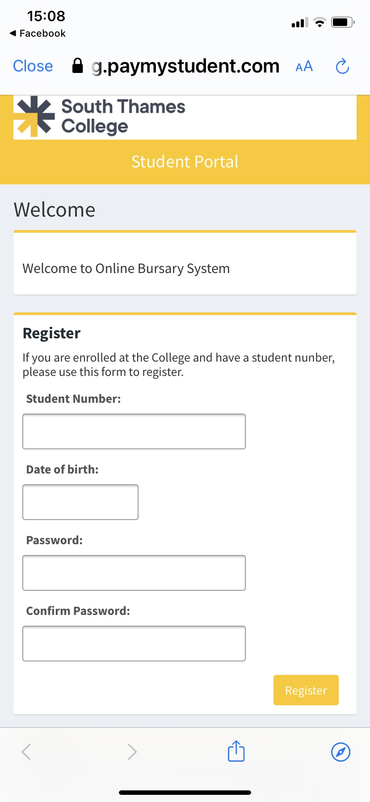
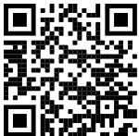
Financial Assistance
South Thames Colleges Group (paymystudent.com)
Household income of less than £30,000 a year
16-19 Bursary
Free College Meals
Childcare Bursary
Travel
19+ Learner Support Fund

Slide 12

Let’s Talk
Counselling and Wellbeing Hub
Everyone has emotional health, just like physical health
We need to make sure that we take regular wellbeing MOT’s
Confidential, safe spaces to talk about anything that is worrying you

Slide 13

  Your Student Support Team will let you know how to access this resource
Mental Wellbeing Support
We believe it’s important to provide a place of safety without judgement for people to get together to support each other, whilst also recognising mental health does not discriminate; we all have to look after it.
Notes:
All Students will receive exclusive access to TOGETHERALL

Slide 14























Slide 15



















Slide 16



Slide 17



Slide 18



Slide 19
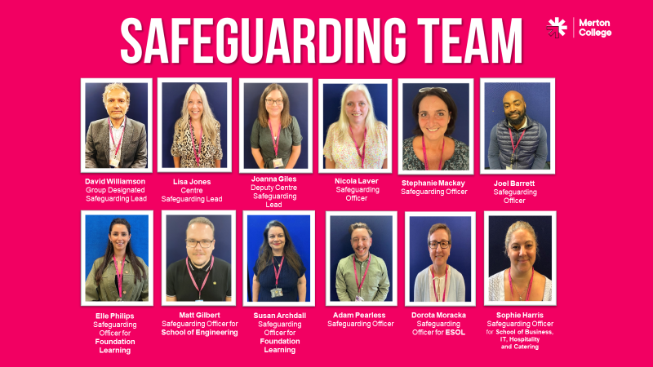


Slide 20
mcstudent.support@stcg.ac.uk Merton College
If you would like to speak to one of the team about anything we have covered tonight, please email or come and talk to us after this presentation.

Slide 21



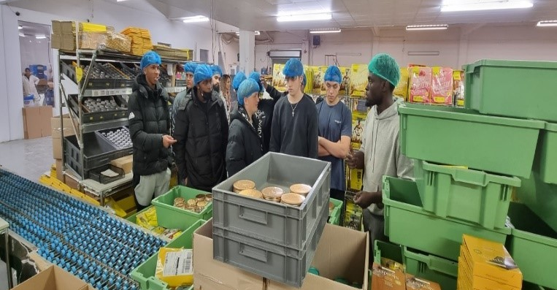
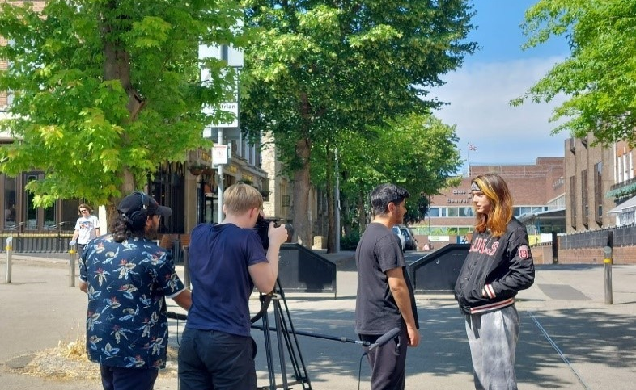
Work Experience & Employability
Angela Woolnough
Head of Employability

Slide 22

The Employability Service
Merton College has a dedicated Employability Team who support students in two main areas:
Work Experience
Employability

Slide 23

Work Experience and Employability
All students are expected to complete work experience with an employer.
Students will be able to put the skills and knowledge gained in college into practice and learn new skills to prepare them for the work.
We also aim for each students to have 2 interactions with employers each term.

Slide 24

Work Experience
Work Experience Placements are usually a minimum of 36 hours.
Students usually attend 1-2 days each week or in block/full weeks.
Relevant part-time work and volunteering work can be used as Work Experience
Some courses may require additional hours to meet qualification requirements ( eg: childcare and health and social Care)
2nd year student and applying for HE may have reduced placement hours

Slide 25

















Our Employer Network Includes…

Slide 26
Employability Activities
Creating a CV, applying for work and interview skills
Employability modules and virtual work experience
Workshops and employer talks to help prepare for the workplace
Employer visits and insight days
Attend Career's, Jobs Employability Fairs
Participating in community projects, employer briefs, tasks and competitions

Slide 27
Please support your child to secure a work placement and to participate in employability activities.
If you, or you know of someone who can provide a student with Work Experience or Part-Time Employment, please get in touch.
How Can You Help?

Slide 28
Employability: Help and Support
Students can drop-in or make an appointment with the Employability Team:
Angela Woolnough
angela.Woolnough@stcg.ac.uk
Head of Employability Merton & Carshalton Colleges
Carshalton: Tel: 0208 268 3188
Merton : Tel: 0208918 7467
Jeanette Bryant
jeanette.bryant@stcg.ac.uk
Merton Employability Coordinator Tel: 020 8918 7355
Based in the admissions office at Merton College

Slide 29

Inclusion Learning
‘Supporting your learning journey.’

Slide 30
The Team
Adam Pearless
Head of Inclusive Learning
Adam.Pearless@stcg.ac.uk
Pratibha Patel
Specialist Tutor (EAA)
Pratibha.patel@stcg.ac.uk
Ebony Keane
Inclusive Learning Manager
Lovina Lansana
Inclusive Learning Officer
Lovina.lansana@stcg.ac.uk
Ebony.Keane@stcg.ac.uk
Carol Trusty
Progress Co-ordinator –Catering & Hospitality, Hair and Beauty, Health and Social Care, Sciences
carol.trusty@stcg.ac.uk
Louise Hart
Progress Co-ordinator - Business IT, Electrical Installation, Engineering
Louise.Hart@stcg.ac.uk

Slide 31
What support is available?
We encourage learners to disclose a learning difficulty, disability or health condition on application. We may recommend the below once your needs are assessed:
Tutor Led Support
Specialist Support

Slide 32
Specialist Support
If it is assessed that the young person has a learning difficulty, disability or health condition that significantly impacts on their learning, they will be assigned classroom inclusive support. The nature of this will depend on the information contained within their Educational Health and Care plan.
In addition to tutor led and individual support. The college offers arrange of other services to the learners Including Communicators for the deaf. Scribes and exam access arrangements which provides additional support during the exam process.
The college also has a team of occupational and speech and language therapists who support the tutors in delivering the best possible experience for our young people.

Slide 33
Support with Learner’s with Educational Health Care Plans
What type of SEND support is available if you have an EHCP
The Inclusive Learning team will agree a package of support with the young person. This is to help themto achieve on their course, meet the outcomes in the EHCP and leading the young person to be be as independent as possible.
All learners with an EHCP are allocated a Progress Coordinator who will coordinate their support, organize annual reviews and act as your point of contact.
The types of support that may be offered are:
In class support for learners with a range of learning difficulties.
Out of class support in the form of 1:1’s, small groups or drop-in’s.
Exam access arrangements for e.g. extra time, reader, scribe, for learners with a range of learning difficulties.
Specialist software to support reading and proofreading for learners with literacy difficulties.
Speech and language, Occupational Therapy and 1:1, social skills groups.
Mental health support

Slide 34
Support for learners without EHCPS
Your support will be Tutor Led, as previously mentioned. In addition you may be offered;
Exam access arrangements this could involve such things as extra time and individual accommodation.
BSL communicator and or note takers for learners who have a hearing impairment.
Specialist software, adapted equipment or note takers for learners who are blind or visually impaired.
Personal care for learners who have a physical need and or disability.
Drop-in sessions which will be available to all students.
Targeted booster classes for Maths and English.

Slide 35
Disabled Student’s Allowance
If you have a disability, mental health condition or learning difficulty and are on a higher education/undergraduate course, you may be eligible for funding to help with your studies called Disabled Students' Allowance. It does not need to be repaid.
If you feel that this applies to you, you must apply for Disabled Students' Allowance (DSA) when you submit your student finance application (UCAS).
This will only apply to students applying to a higher education course.

Slide 36
Meet the Curriculum Teams
Questions and Answers

Slide 37


