Slide 1



Careers Information,
Advice & Guidance
How the Careers Service will support your child through their college journey.

Slide 2
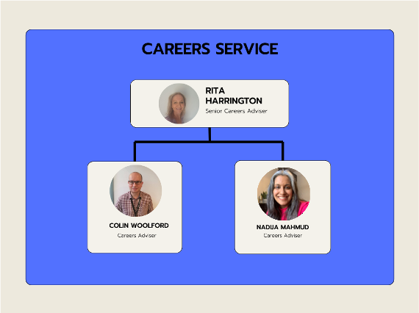
Careers Advice Service

Slide 3

Careers Advice Service
Careers advice and information
Choosing the right course
CVs, interviews and job searching
UCAS and Personal Statements
Apprenticeships
Part time jobs and voluntary work
Gap years

Slide 4

Personalised Careers Advice
Students can access a qualified Careers Adviser for one-to-one guidance appointments at the main site, CIC or virtually via Teams.

Slide 5
Daily Careers Drop-in
For quick Careers queries students can attend the daily drop-in from 12pm to 2pm.
KHR-G40 (Student Support Centre)
CIC-109 (Tuesday & Friday only)

Slide 6
Careers Programme
During your child’s time at college they may be involved in or attend the following Careers activities:
Undergraduate Fair
Careers Fair
Employability Weeks
Careers presentations / workshops during tutorials

Slide 7



Careers Resources
All students have access to Kudos, the online Careers resource.
Kudos will give them all the information they need to make important decisions about future careers and what subjects, courses and training they can do to reach their career destinations.
@MyCollegeZone is the college student portal where they can access a range of careers resources and information via the Careers & Employability Hub.
@MyCollegeZone →
Careers & Employability Hub
Encourage your child to regularly check the MySTCG app for all the latest information from the Careers Service.

Slide 8



Contact Information
If you need more information or have any unanswered questions, please do not hesitate to contact us.
0208 268 2555
careers@stcg.ac.uk
https://stcg.ac.uk/kingston-college/parent

