Slide 1



Kingston College Student Services

Slide 2
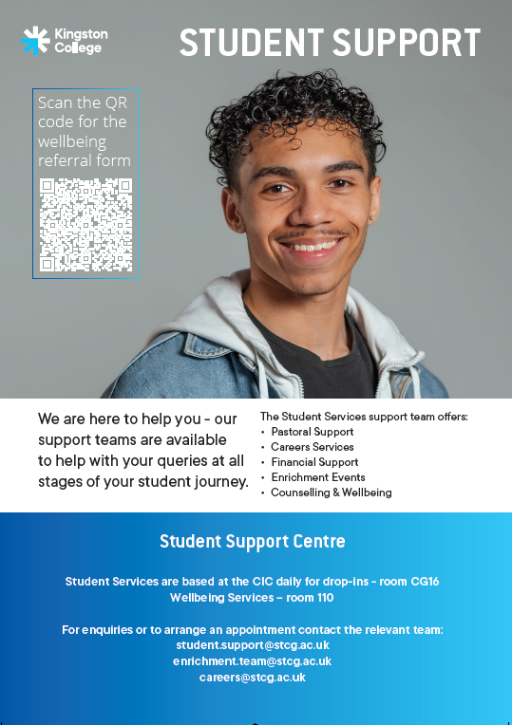
Student Support Services
Careers Advice
Bursary
Wellbeing support
Enrichment / Student Council
Counselling

Slide 3







What do we do?
Bursary
Household income of £30,000 or less
Careers
Help with UCAS, CVs and Interviews
Wellbeing
Support with any issues you might be facing
Emotional support with a counsellor or NHS Wellbeing Practitioner to better support your wellbeing
Counselling
KC Xtra -Enrichment
Fun, interactive and skills-development activities

Slide 4
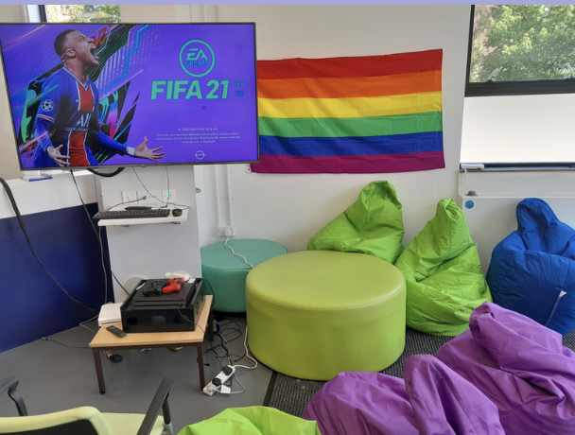
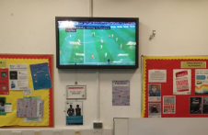
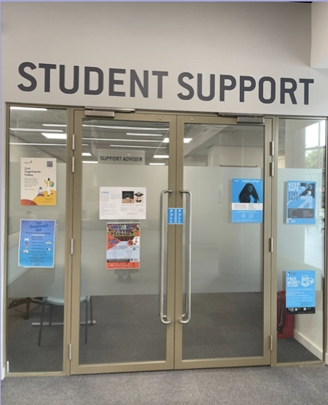
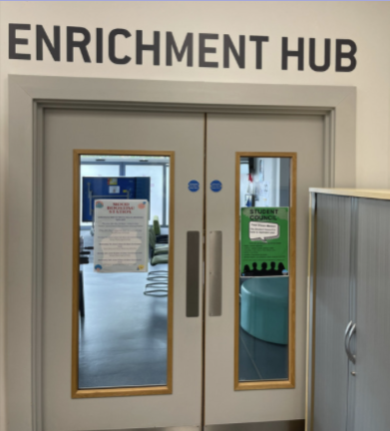
Where are we?
Student Services Centre – G40
Open:
Mon-Thurs: 10am – 3pm
Friday: 10am - 2pm
Enrichment Hub:
Open: Mon-Fri 12 – 5pm
Café:
Open: Mon-Fri 3-5pm
CIC base:- CG16 on Ground floor and room 110 on 1st floor

Slide 5



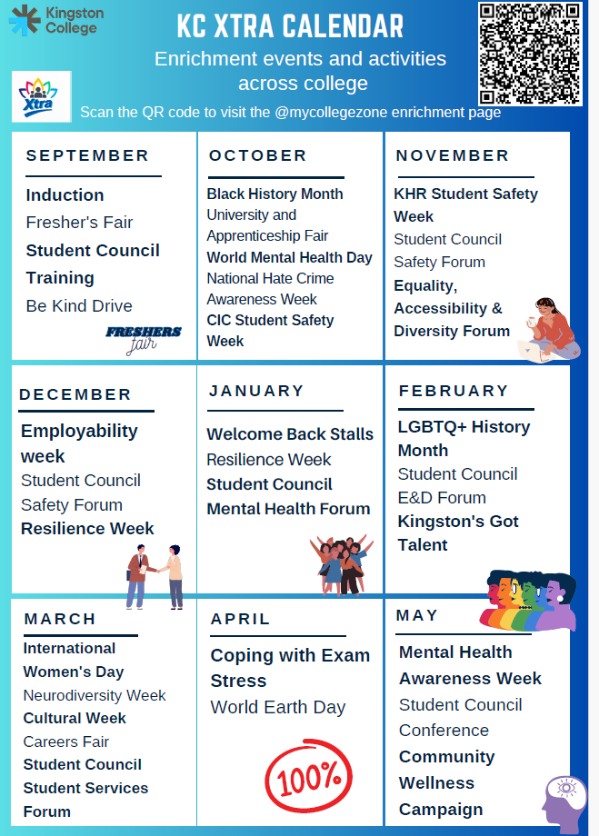


KC xTRA - Events and Clubs

Slide 6



Student Council and Governor – Your Voice
Get involved, volunteer, or have your say and join the Student Council

Slide 7



Online Support Resources

Slide 8


Keep Safe, Stay Safe
We are here to help, listen and support
Please speak to a Tutor, Safeguarding Officer or a member of the Student Support team

Slide 9

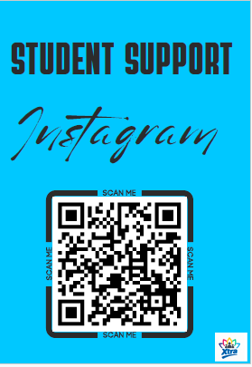
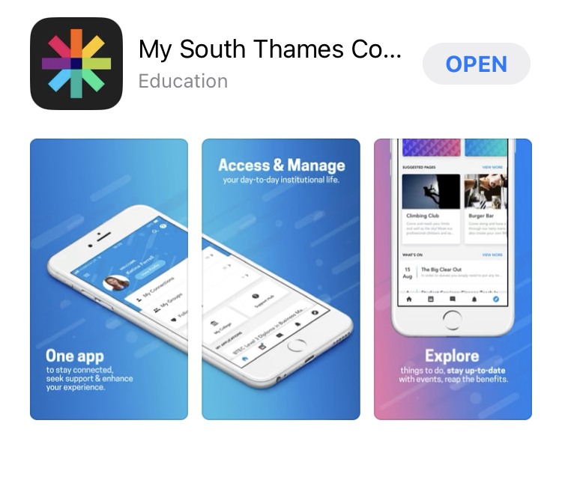
Further Information
Check out ‘My College Zone’ for more information on support and resources available to you while in college.​
Click the link here: My College Zone​
​
‘My South Thames College’ App:
Download the college app today, to stay up to date with all the latest college news and events

Slide 10

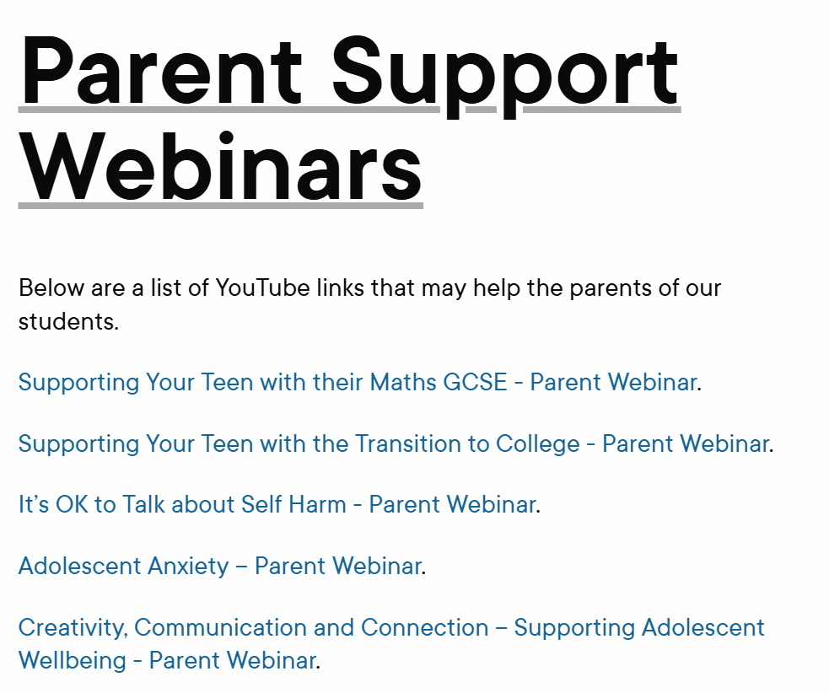
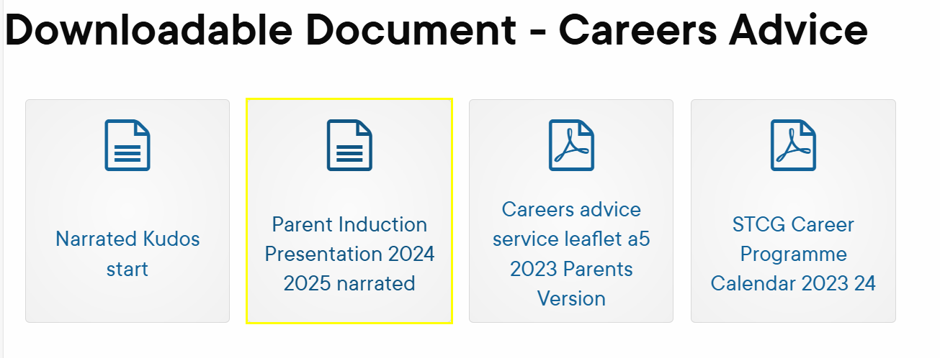
Parent – Webpages for more information.... here
Careers Parent Induction - Here

Slide 11

Thank You – any questions? Student.support@stcg.ac.uk
0208 268 2969

